Slide 1
MATRICES
Introduction
Types of Matrices
Equality of Matrices
Addition of Matrices
Multiplication Of Matrices
Transpose of Matrices
Symmetric & Skew Symmetric Matrices
Inverse Of Matrices
Elementary Transformation

Slide 2
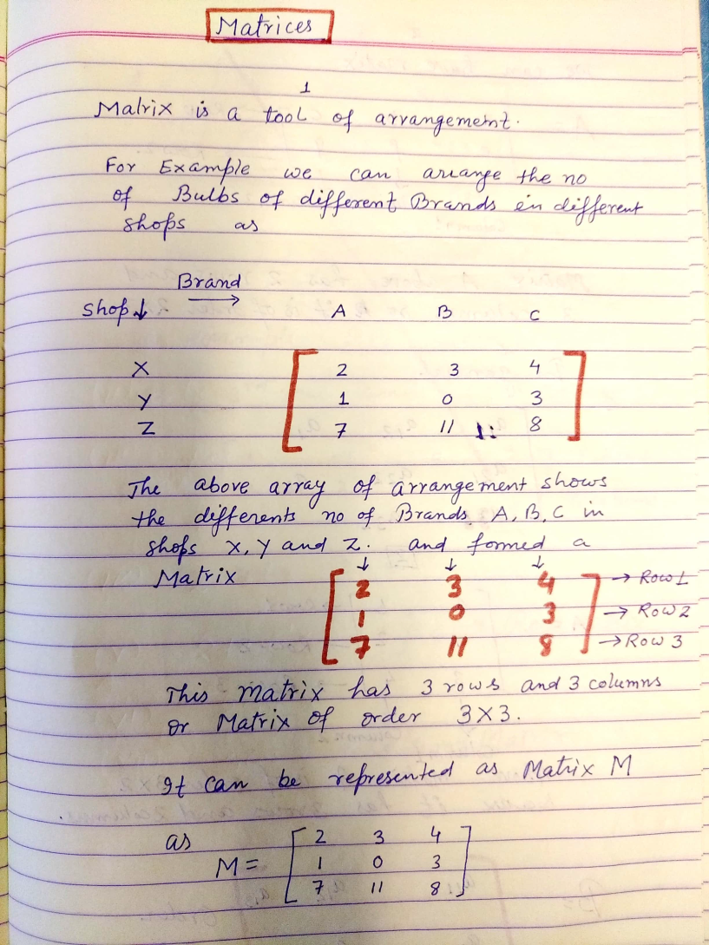
Matrix

Slide 3
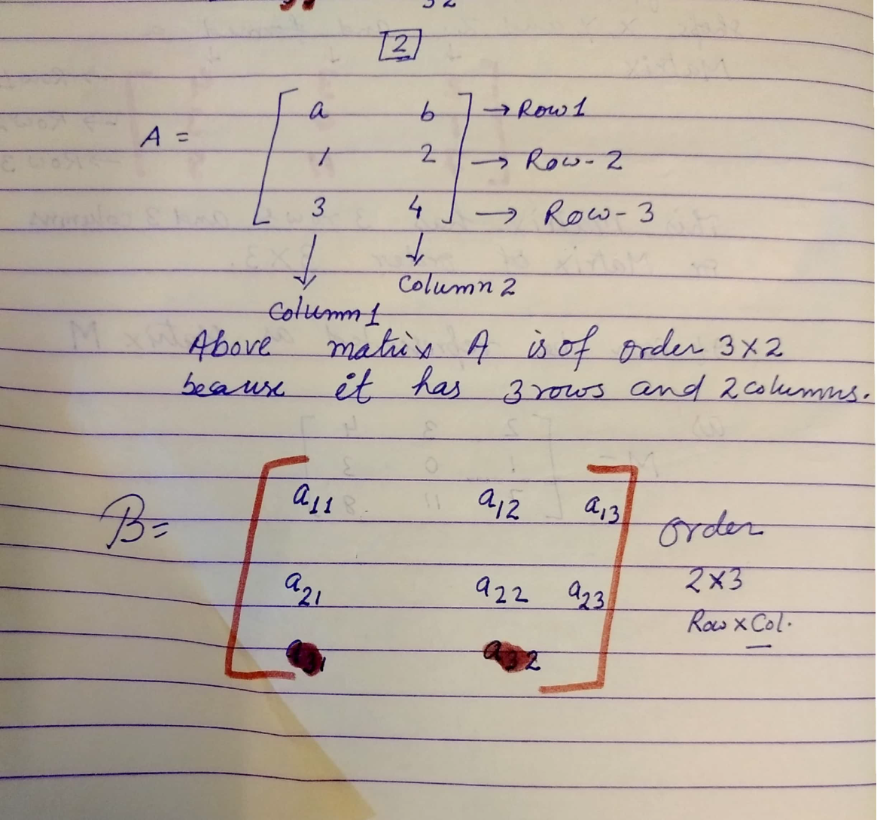
Matrix: Introduction

Slide 4
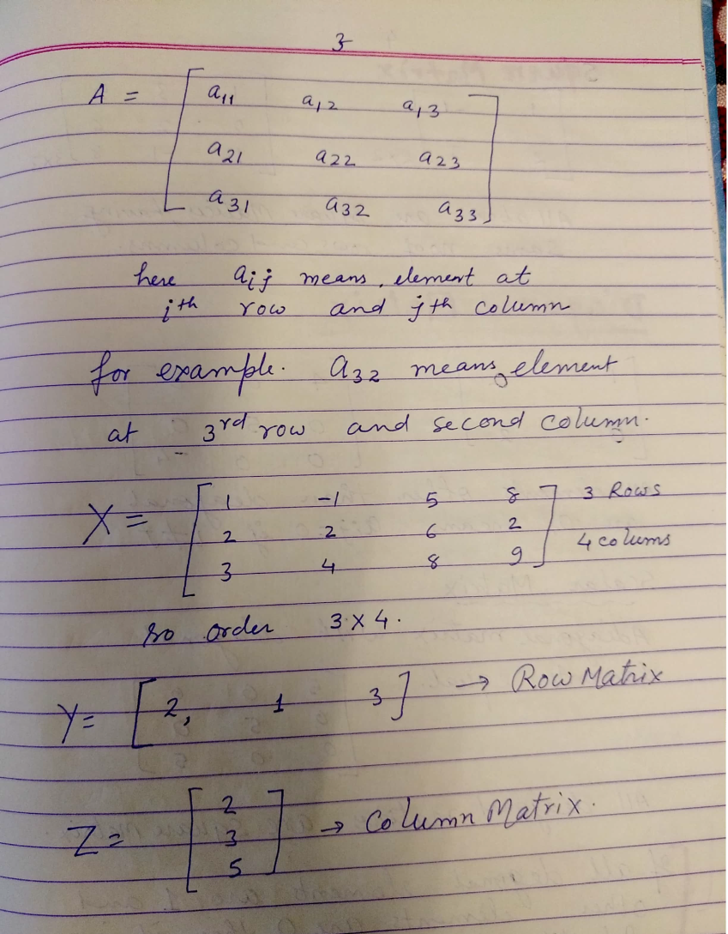
Matrix: Introduction

Slide 5
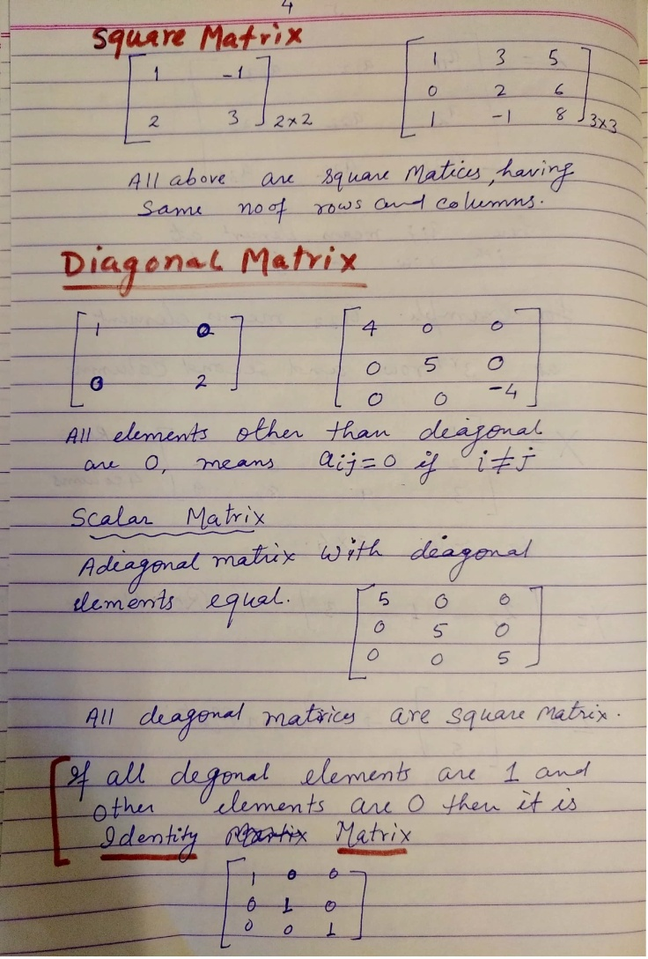
Types of Matrices

Slide 6
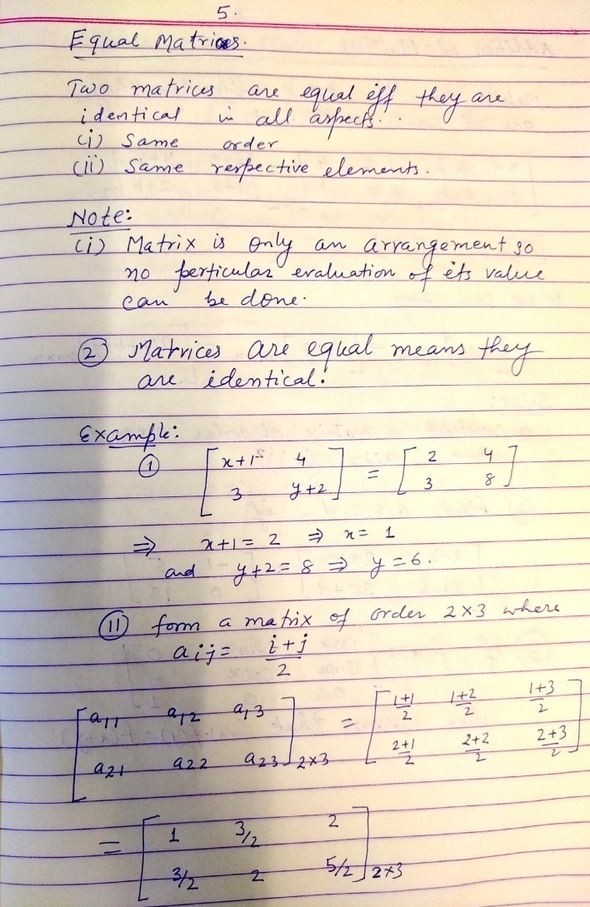
Equality of Matrices

Slide 7
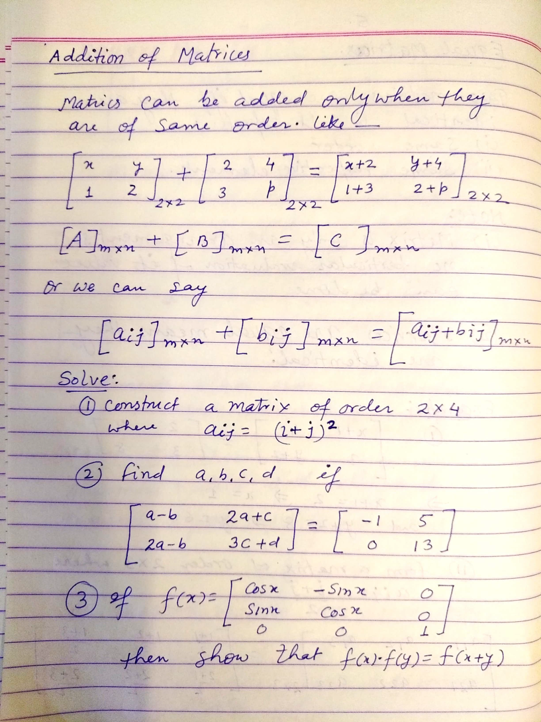
Addition Of Matrices

Slide 8
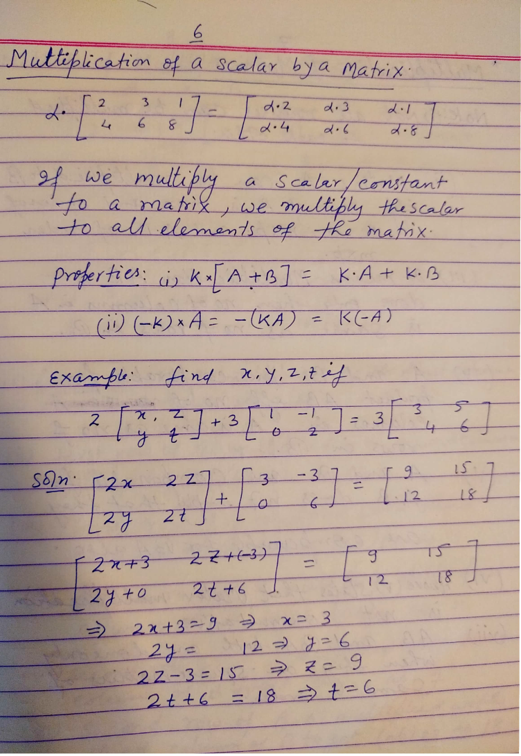
Multiplication Of Scalar with Matrices

Slide 9
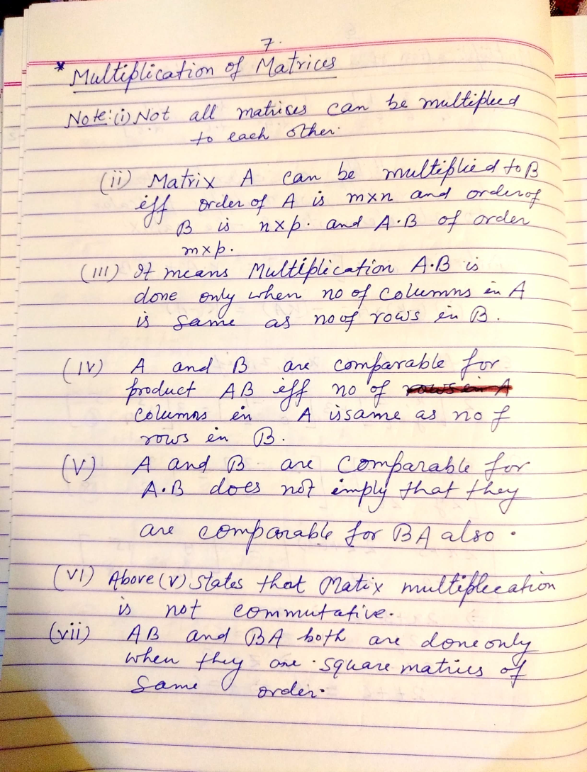
Multiplication Of Matrices

Slide 10
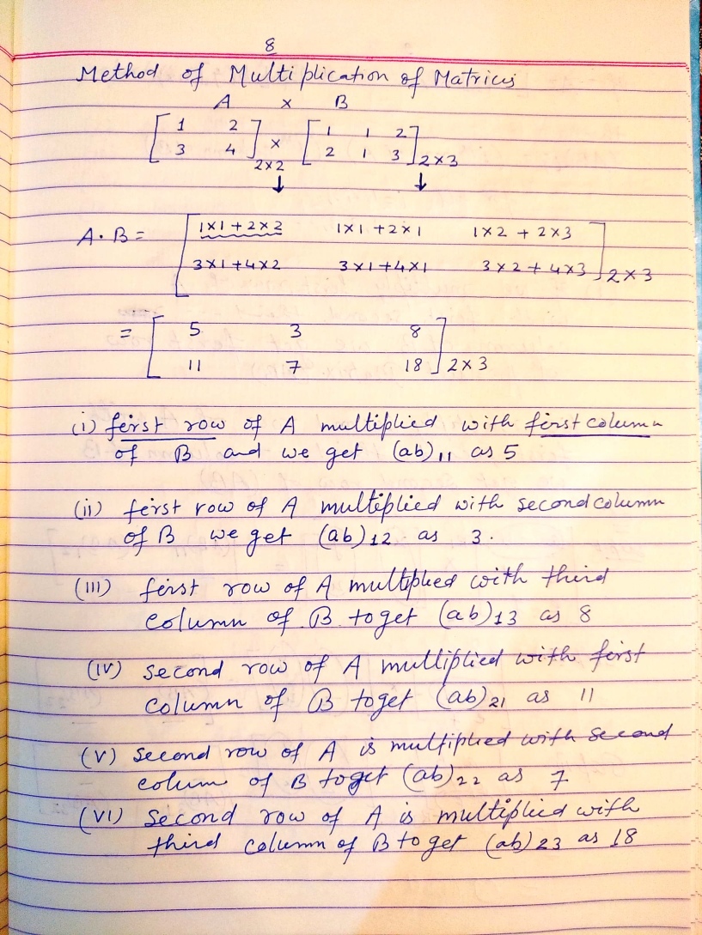
Multiplication Of Matrices

Slide 11
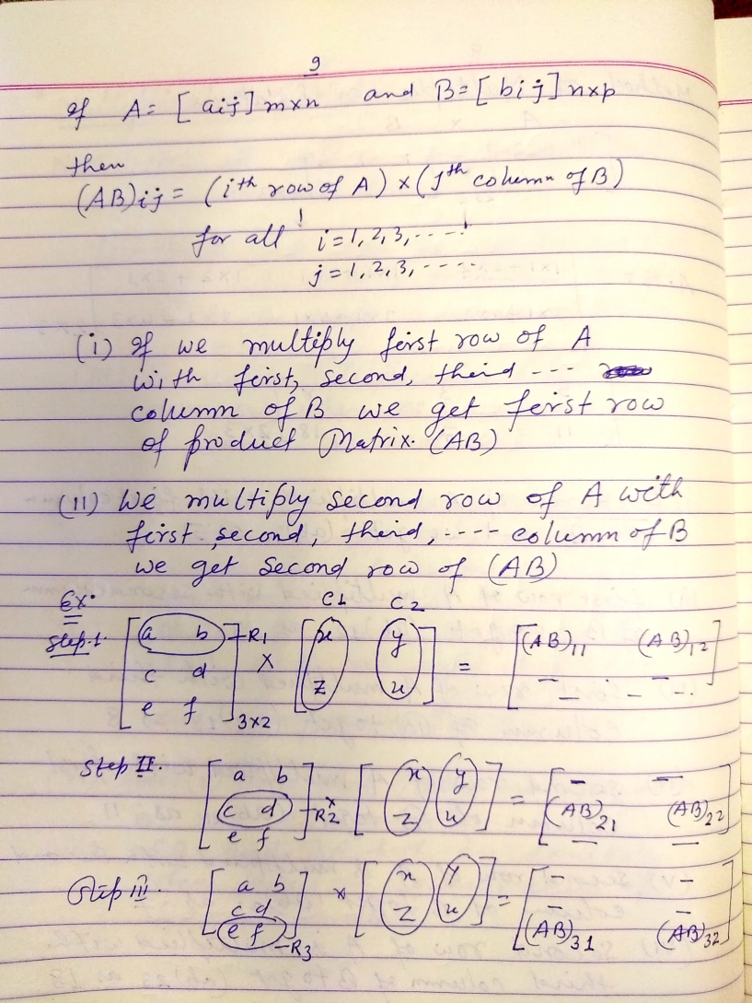
Multiplication Of Matrices

Slide 12
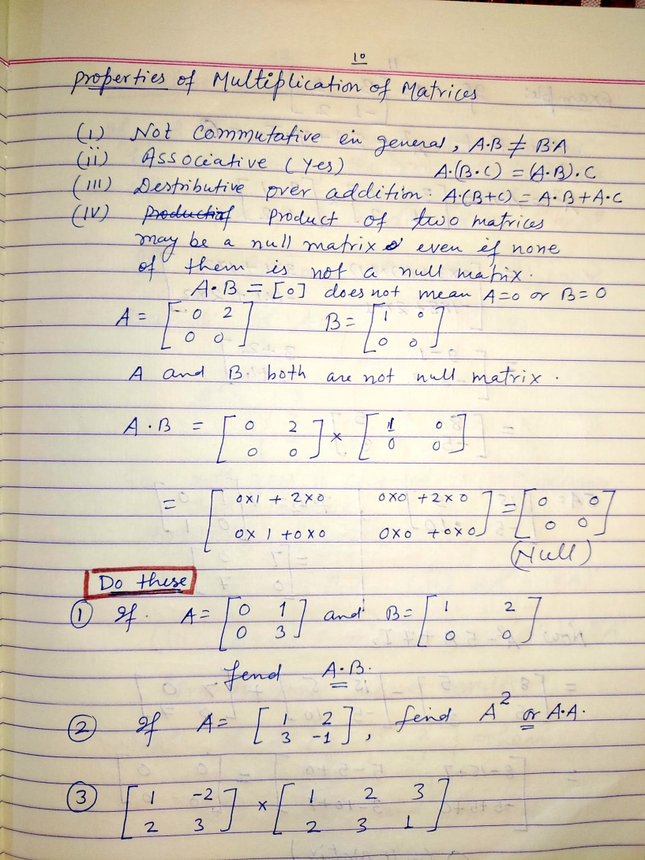
Multiplication Of Matrices

Slide 13
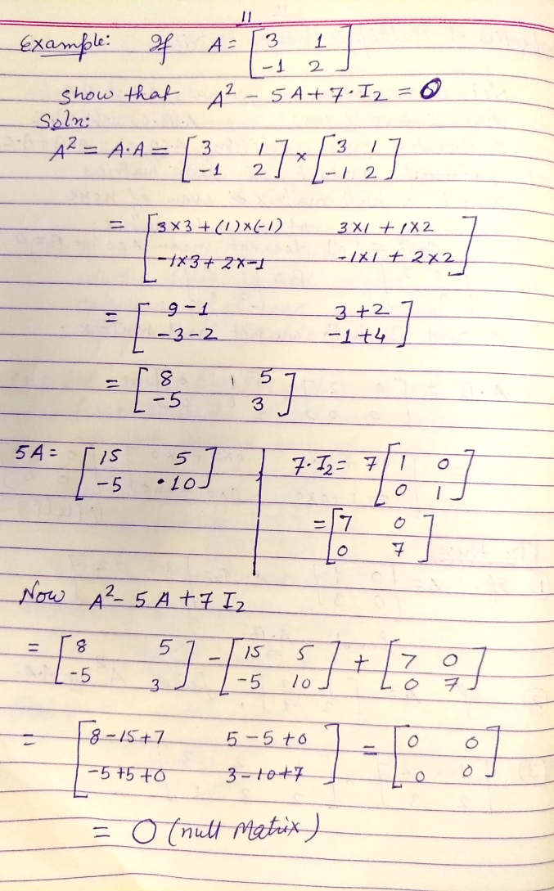
Multiplication Of Matrices

Slide 14
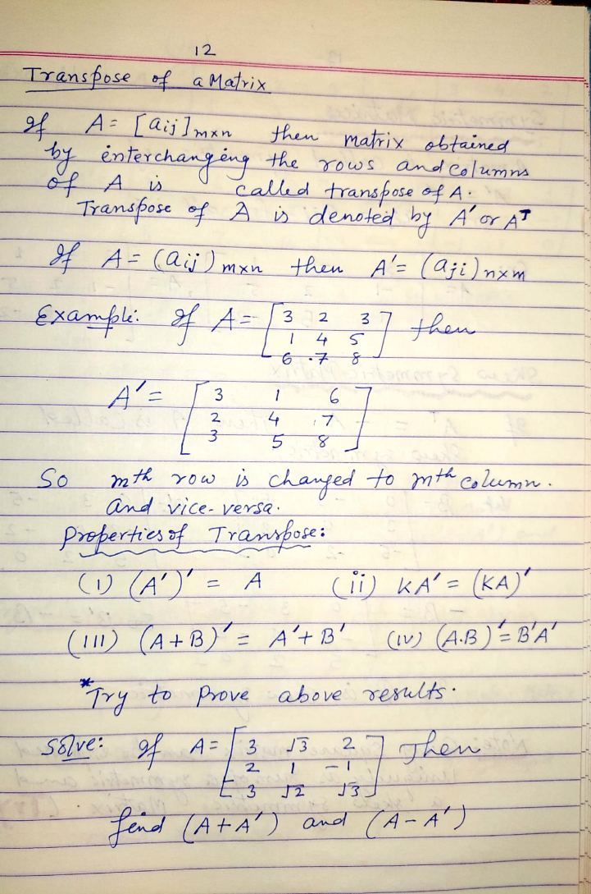
Transpose of Matrix

Slide 15
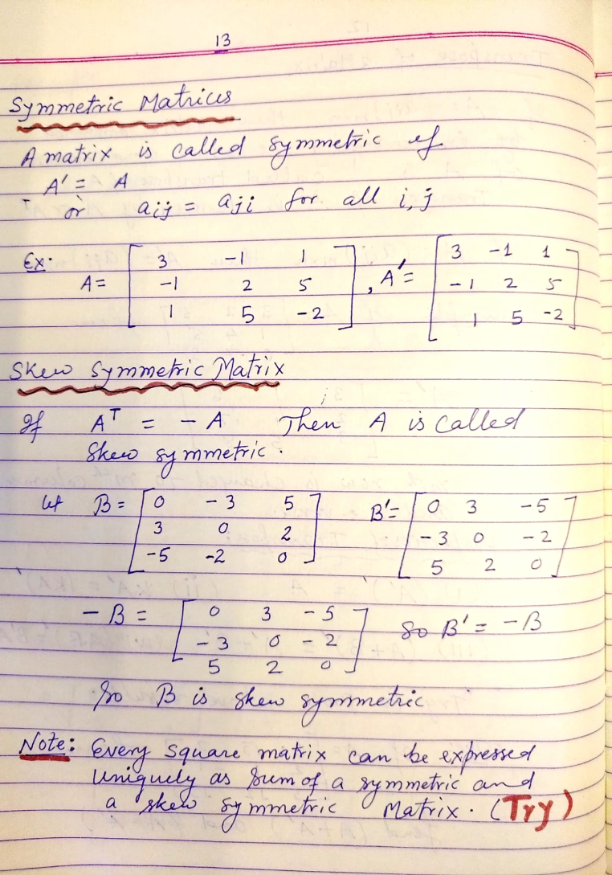
Symmetric & Skew symmetric matrices

Slide 16
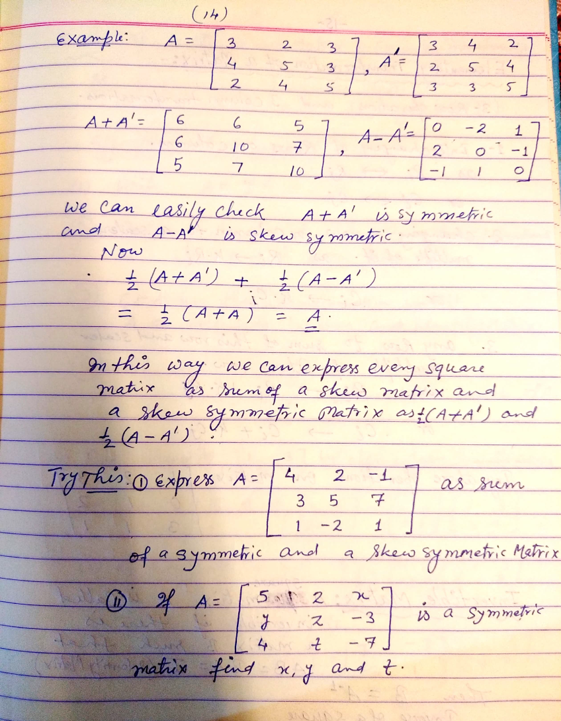
Matrix = Symmetric + Skew symmetric matrices

Slide 17
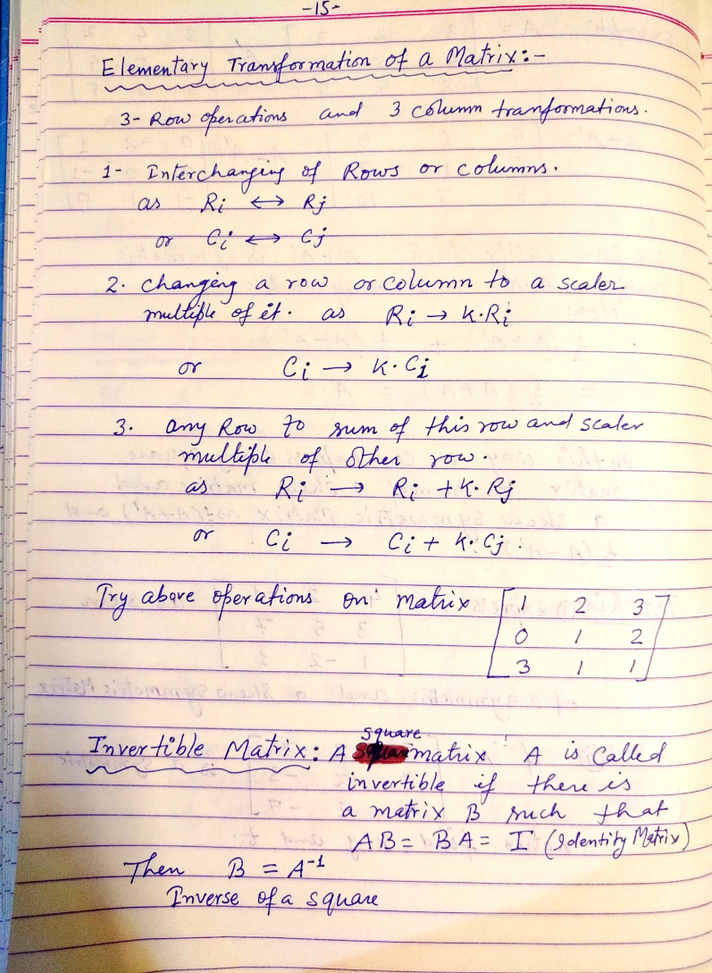
Elementary Transformations in Matrices

Slide 18
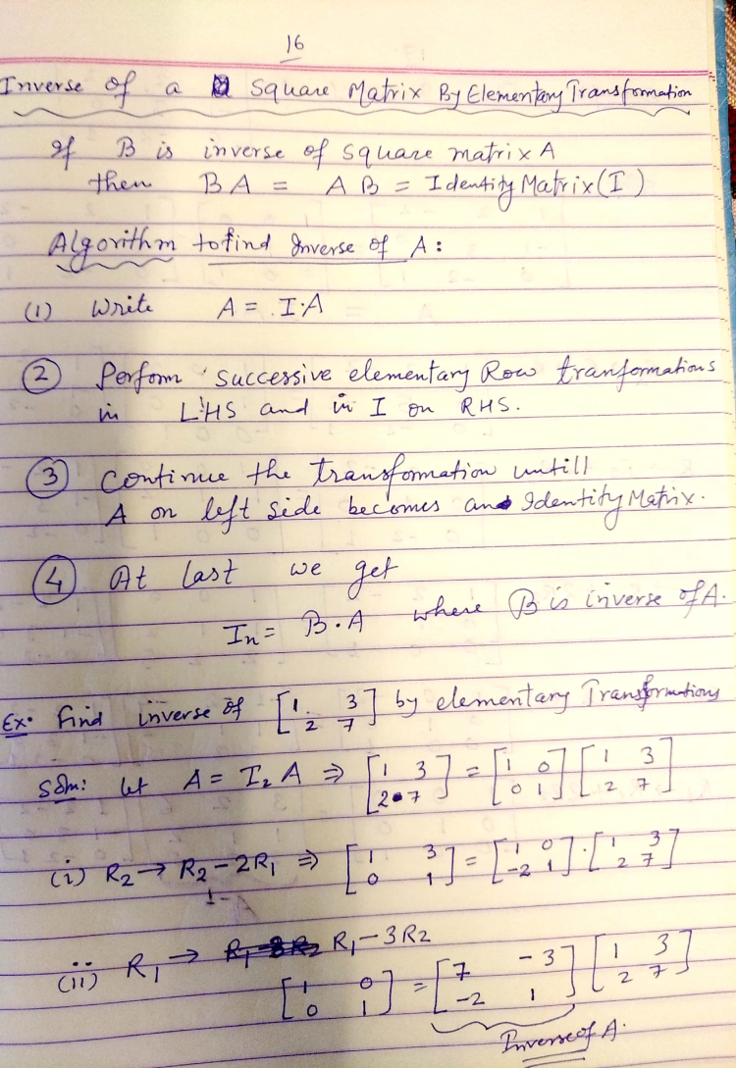
Elementary Transformations in Matrices

Slide 19
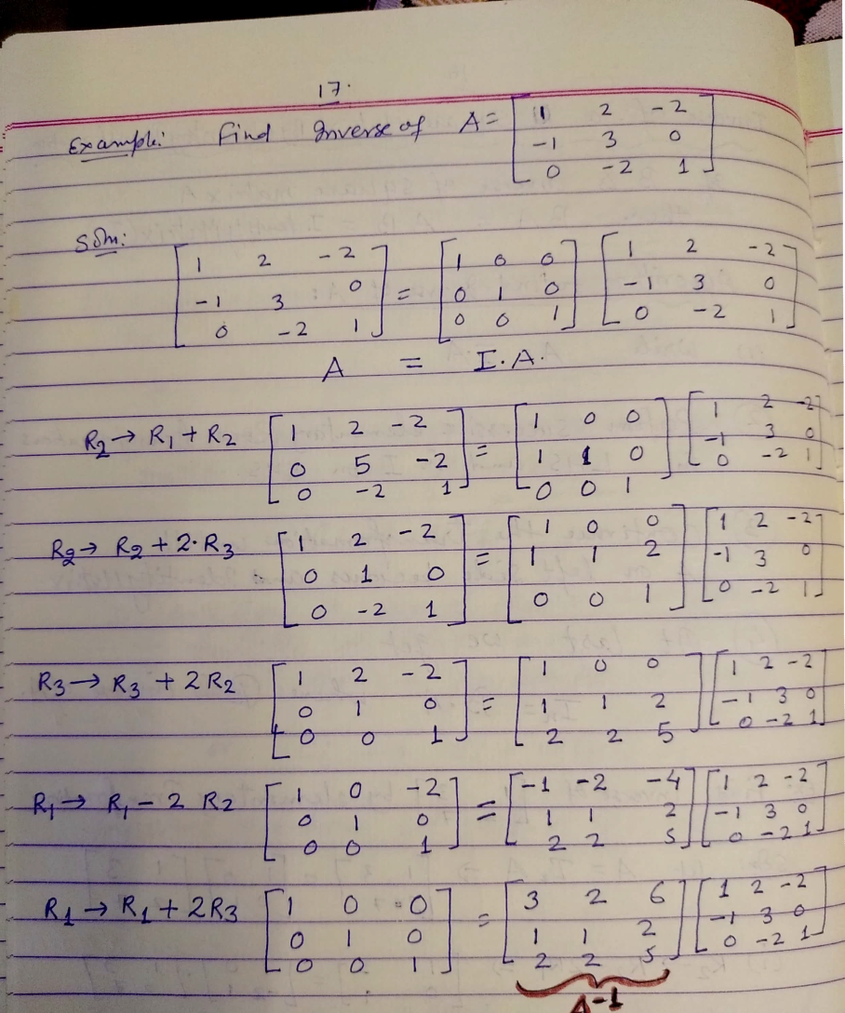
Inverse of Matrix By Elementary Transformations

Slide 20
THANK YOU

